Slide 1
Exam 70-777 Implementing Microsoft Azure Cosmos DB Solutions
Partition and Model Data
Replicate Data Across the World
Tune and Debug Azure Cosmos DB Solutions
Perform Integration and Develop Solutions
https://www.microsoft.com/en-ie/learning/exam-70-777.aspx
Notes:
20533D
1: Introduction to Microsoft Azure

Slide 2
Tune and Debug Azure Cosmos DB Solutions
Estimate and provision request units
Tune container settings
Implement security
Debug a Cosmos DB solution

Slide 3
Tune and Debug Azure Cosmos DB Solutions
Estimate and provision request units
Differentiate requests and request units; retrieve request unit cost of an operation; estimate request unit allocation for a container; tune throughput for uneven workloads and manage throttling; monitor Azure portal metrics; recommend solutions based on query metrics
Tune container settings
Manage lifecycle of data by using TTL; tune an index policy; include and exclude properties from index paths
Implement security
Secure access to data; rotate keys; understand encryption at rest and in transit; configure IP firewalls; create and manage users; configure fine-grained access to resources
Debug a Cosmos DB solution
Configure diagnostic logging; recommend solutions based on data retrieved from logs; evaluate response status code categories; throttle; review metrics and performance tips
https://www.microsoft.com/en-us/learning/exam-70-777.aspx
Notes:
The following topics are not included in this presentations due to time constrains

Slide 4
Estimate and provision request units
Differentiate requests and request units
Retrieve request unit cost of an operation
Estimate request unit allocation for a container
Tune throughput for uneven workloads and manage throttling
Monitor Azure portal metrics
Recommend solutions based on query metrics
https://www.microsoft.com/en-ie/learning/exam-70-774.aspx

Slide 5

Request Units
Notes:
Why do we need it?
Billing mechanism
Deterministic way of showing how much resources are allocated to you

Slide 6
Request Units
% CPU
Request Units
Request Units (RU) is a rate-based currency
Abstracts physical resources for performing requests
Key to multi-tenancy, SLAs, and COGS efficiency
Foreground and background activities
% Memory
% IOPS
https://azure.microsoft.com/en-us/pricing/details/cosmos-db/
Notes:
Cost Of Goods Sold (COGS)
Azure Cosmos DB is designed to allow customers to elastically scale throughput based on the application traffic patterns across different regions to support fluctuating workloads varying both by geography and time. Operating hundreds of thousands of globally distributed and diverse workloads cost-effectively requires fine-grained multi-tenancy, where hundreds of customers share the same machine and yet thousands share the same cluster. To provide performance isolation to each customer while operating cost-effectively, we’ve engineered the entire system from the ground up with resource governance in mind. As a resource governed system, Azure Cosmos DB is a massively distributed queuing system with cascaded stages of components, each carefully calibrated to deliver predictable throughput while operating within the allotted budget of system resources. In order to optimally utilize the system resources (CPU, memory, disk, and network) available within a given cluster, every machine in the cluster is capable of dynamically hosting from 10s to 100s of customers. Rate-limiting and back-pressure are plumbed across the entire stack from the admission control to all I/O paths. Our database engine is designed to exploit fine-grained concurrency and to deliver high throughput while operating within frugal amounts of system resources.

Slide 7
Request Units
GET
Request Units
Normalized across various access methods
1 RU = 1 read of 1 KB document
Each request consumes fixed RUs
Applies to reads, writes, queries, and stored procedure execution
POST
PUT
Query
…
Notes:
The number of database operations issued within a unit of time (i.e., throughput) is the fundamental unit of reservation and consumption of system resources. Customers can perform wide range of database operations against their data. Depending on the operation type and the size of (the request and response) payload the operation may consume different amounts of system resources. In order to provide a normalized model for accounting the resources consumed by a request, budget system resources corresponding to the throughput a given resource partition needs to deliver, and charge the customers for throughput across various database operations consistently and in a hardware agnostic manner, we have defined an abstract rate-based currency for throughput called Request Unit or RU, which is available in two denominations based on the time granularity - request units/sec (RU/s) and request units per minute (RU/m).
Write takes more operations compared to read?
Consistency. Writing to multiple machines
Showing you one page at a time for query to the amount of data so optimize to reduce the RU
Consumed VS provisioned
Can’t use consumed, has to be provisioned.

Slide 8
Request Units
Request Units
Provisioned in terms of RU/sec
Rate limiting based on amount of throughput provisioned
Can be increased or decreased instantaneously
Metered Hourly
Background processes like TTL expiration, index transformations scheduled when quiescent
Rate limit
Max RU/sec
No throttling
Incoming Requests
Min RU/sec
Replica
Quiescent
Notes:
Customers can elastically scale throughput of a container by programmatically provisioning RU/s (and/or RU/m) on a container. Internally, the system manages resource partitions to deliver the throughput on a given container. Elastically scaling throughput using horizontally partitioning of resources requires that each resource partition is capable of delivering the portion of the overall throughput for a given budget of system resources.
As part of the admission control, each resource partition employs adaptive rate limiting. If the resource partition receives more requests within a second than it was calibrated against, the client will receive “request rate too large” with a back-off interval after which the client can retry. Within each second, a resource partition performs (rate limited) background chores (e.g., background GC of the log structured database engine, taking periodic snapshot backups, deleting expired items etc.) within the spare capacity of RUs (if any). Once a request is admitted, we account for the RUs consumed by each micro-operation (e.g., analyzing an item, reading/writing a page, or executing a query operator).

Slide 9
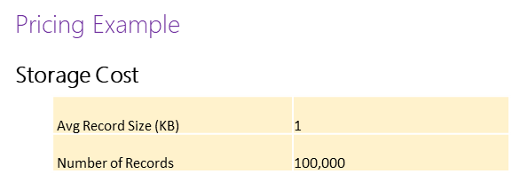
Request Units

Slide 10
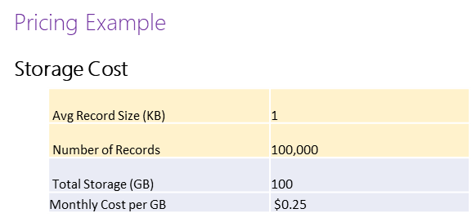
Request Units

Slide 11
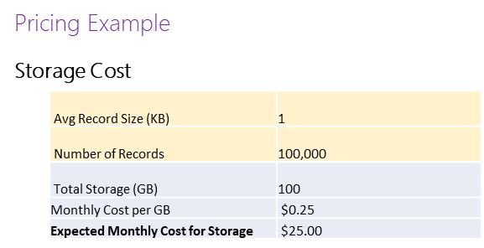
Request Units

Slide 12
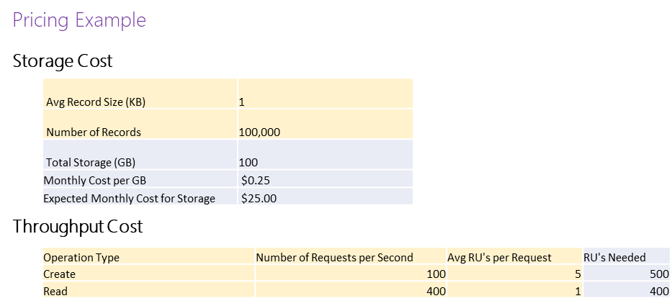
Request Units

Slide 13
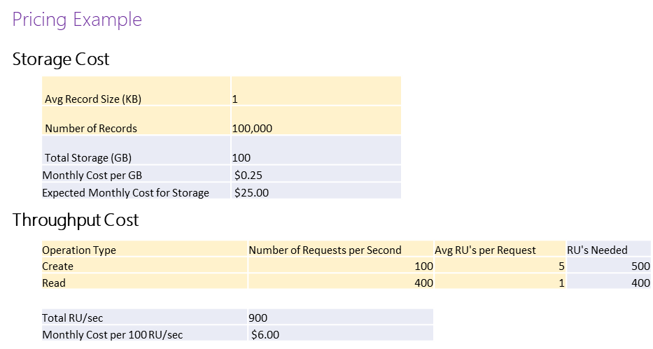
Request Units

Slide 14
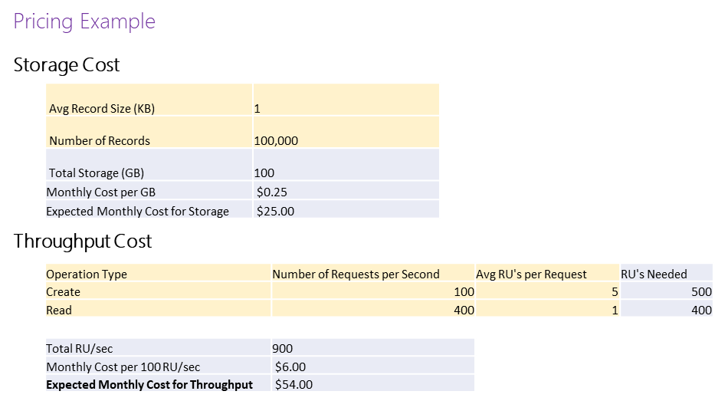
Request Units

Slide 15
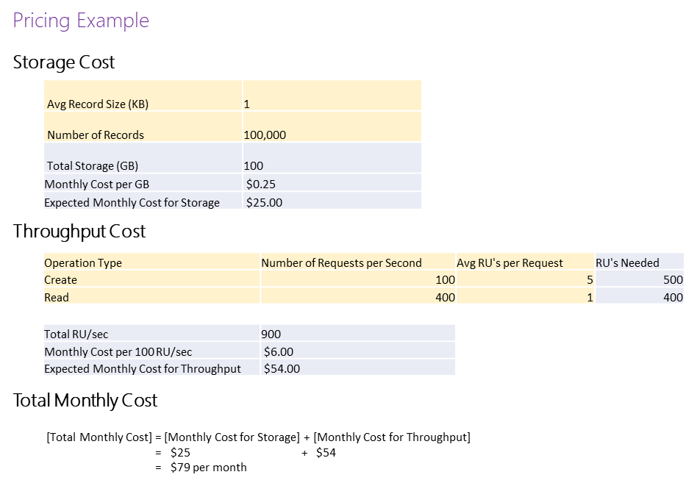
Request Units
Notes:
Scale up and down dynamically to save on cost
Will be on the test, the pricing module and how it is done.
A scenario based on how many RU is needed and how much it will cost

Slide 16
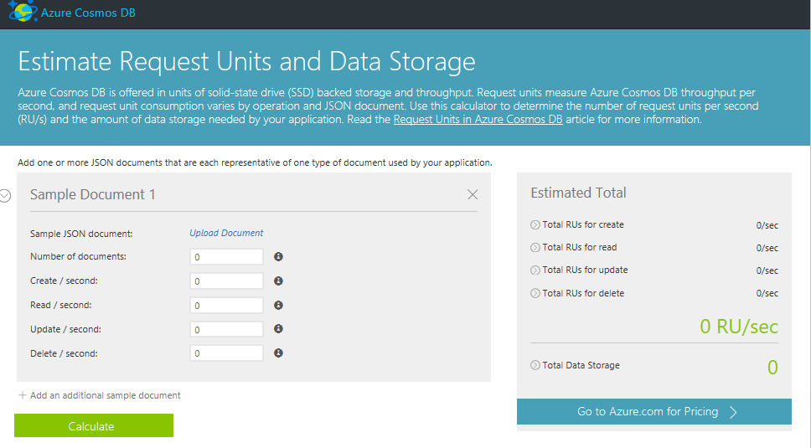
Request Units
https://docs.microsoft.com/en-us/azure/cosmos-db/request-units
Notes:
https://www.documentdb.com/capacityplanner

Slide 17
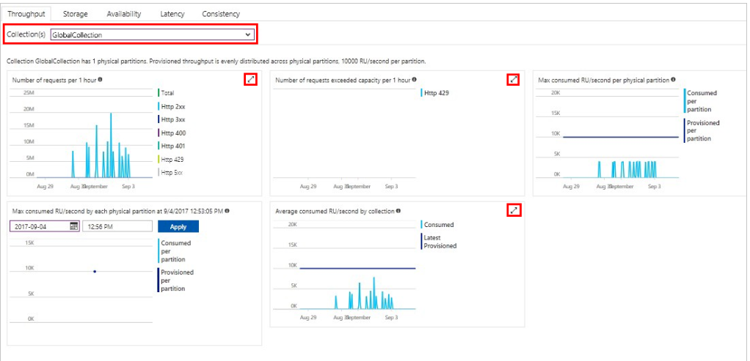
Monitor Azure portal metrics
https://docs.microsoft.com/en-us/azure/cosmos-db/monitor-accounts

Slide 18
Tune container settings
Manage lifecycle of data by using TTL
Tune an index policy
Include and exclude properties from index paths

Slide 19
Manage lifecycle of data by using TTL
By default, time to live is disabled
Can be set programmatically or in the Azure portal
https://docs.microsoft.com/en-us/azure/cosmos-db/time-to-live

Slide 20
Indexing

Slide 21
Indexing
Schema-agnostic, automatic indexing
Automatically index every property of every record without having to define schemas and indices upfront.
No need for schema and index management
Works across every data model
Latch free data structure for highly write-optimized database engine
Multiple index types: Hash, range, and geospatial
Schema
Physical index
https://docs.microsoft.com/en-us/azure/cosmos-db/indexing-policies
Notes:
At global scale, schema/index management is hard
Automatic and synchronous indexing of all ingested content - hash, range, geo-spatial, and columnar
No need to define schemas or secondary indices upfront
Resource governed, write optimized database engine with latch free and log structured techniques
Online and in-situ index transformations
Hash: doesn’t guarantee ordering of continues values
Hash over range: can be smaller
Range: preserve ordering
More information to be saved. So larger
Geospatial: polygons points

Slide 22
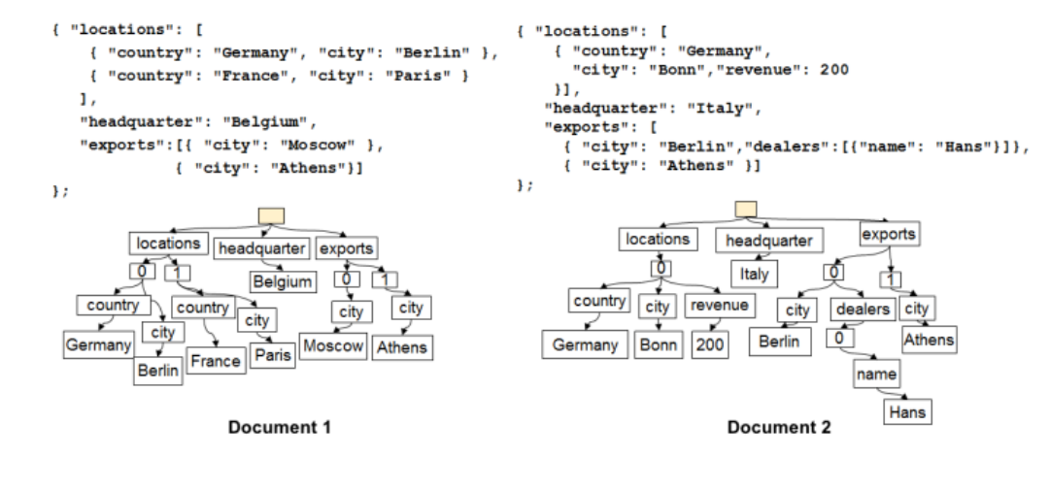
Indexing
Notes:
Uses an inverted index
What is inverted index?
Inverted index
It will create the location and then link it to everything that match it
Regular: document, for this document has word location, and this and that
So for document one, where is location, that is fast
But for every document with location, inverted index is faster

Slide 23
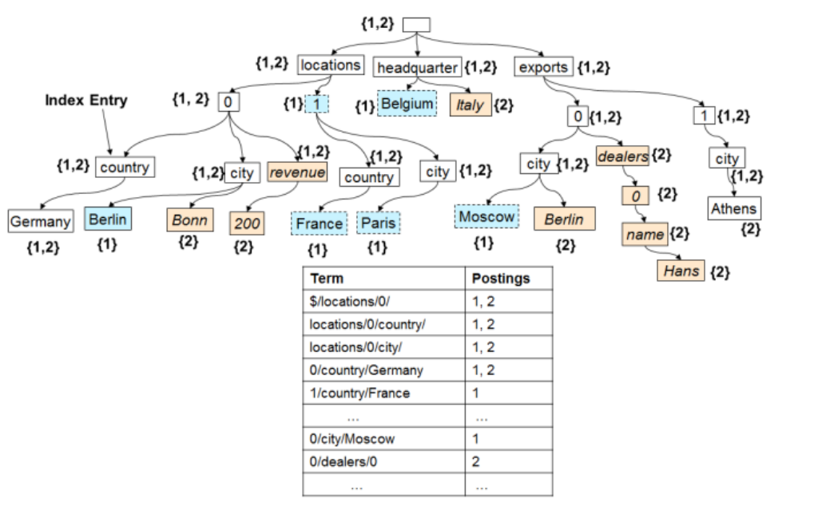
Indexing
Notes:
So we are merging everything together, building a single tree in the background
So a table of all the different properties, so it makes it much easier for

Slide 24
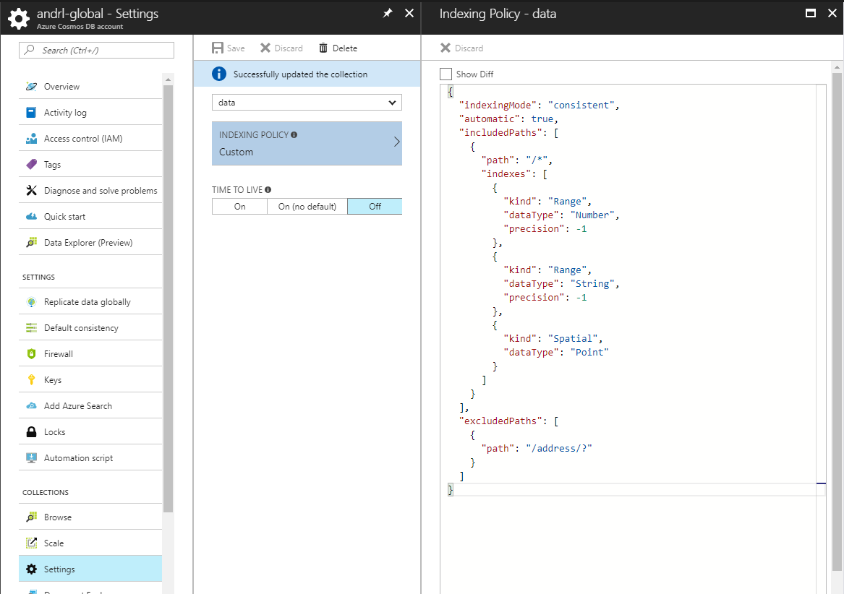
Indexing
Notes:
What to index and what to remove
Include path:
Exclude paths:

Slide 25
Customizing the Indexing Policy for a Collection
Customizing the Indexing Policy for a Collection
Notes:
Demo 2: Customizing the Indexing Policy for a Collection
Important: Prior to getting started with this hands-on exercises, you should have already completed the Demo1: Creating a Azure Cosmos DB Instance hands-on exercise.
In a new browser window, sign in to the Azure Portal (https://portal.azure.com).
In the Jumpbar, click More Services, locate the Databases section, and then click Azure Cosmos DB.
In the Azure Cosmos DB blade that opens, locate and click the Azure Cosmos DB account instance you created earlier in this module.
In the menu on the left-side of the Azure Cosmos DB account blade, locate the Collections section and then click the Query Explorer option in the menu.
In the Query Explorer blade, select the ecommerce database and the customers collection.
Locate the section in the current blade where you can edit the query text New SQL Query.
For the remainder of this hands-on exercise, we will refer to this section as the query editor.
In the query editor, replace the current query with the following query:
SELECT *
FROM customers
ORDER BY customers.address
Click the Execute Query button.
In the Results blade, observe the results of your query.
For this hands-on exercise, we have determined that indexing the address property is inefficient and we would like to remove it from our index. The next steps in this exercise will walk us through the process of excluding a specific JSON path from the index.
Close the Results blade.
Locate the menu on the left-side of the Query # blade. In the menu, locate Scale & Settings
In the Scale & Settings blade, scroll down to Settings.
In the Indexing Policy Within the JSON editor, locate the excludedPaths property that has its value set to an empty array.
{
"indexingMode": "consistent",
"automatic": true,
"includedPaths": [
{
"path": "/*",
"indexes": [
{
"kind": "Range",
"dataType": "Number",
"precision": -1
},
{
"kind": "Range",
"dataType": "String",
"precision": -1
},
{
"kind": "Spatial",
"dataType": "Point"
}
]
}
],
"excludedPaths": []
}
Replace the value of the excludedPaths property with the following array:
[
{
"path": "/address/*"
}
]
Your index should now look like this:
{
"indexingMode": "consistent",
"automatic": true,
"includedPaths": [
{
"path": "/*",
"indexes": [
{
"kind": "Range",
"dataType": "Number",
"precision": -1
},
{
"kind": "Range",
"dataType": "String",
"precision": -1
},
{
"kind": "Spatial",
"dataType": "Point"
}
]
}
],
"excludedPaths": [
{
"path": "/address/*"
}
]
}
Click the OK button at the bottom of the blade.
In the Settings blade, click the Save button at the top of the blade. Wait for the collection “Update” operation to complete.
In the SQL API, locate and click the customers section and then click the New SQL Query option in the menu.
In the query editor, replace the current query with the following query:
SELECT *
FROM customers
ORDER BY customers.address
Click the Run Query button.
The query should fail immediately. Scroll down to the bottom of the Query Explorer blade to view the error message:
"Order-by item requires a range index to be defined on the corresponding index path."
Because the address property is no longer indexed, you are unable to order the document using this property.
Source: edx.org
Microsoft: DAT221xIntroduction to NoSQL Data Solutions

Slide 26
Implement security
Secure access to data
Rotate keys
Understand encryption at rest and in transit
Configure IP firewalls
Create and manage users
Configure fine-grained access to resources

Slide 27
Securing Data
Administrative-level resources
Users and databases
Application-level resources
Collections, documents, attachements or JavaScript logic
https://docs.microsoft.com/en-us/azure/cosmos-db/secure-access-to-data

Slide 28
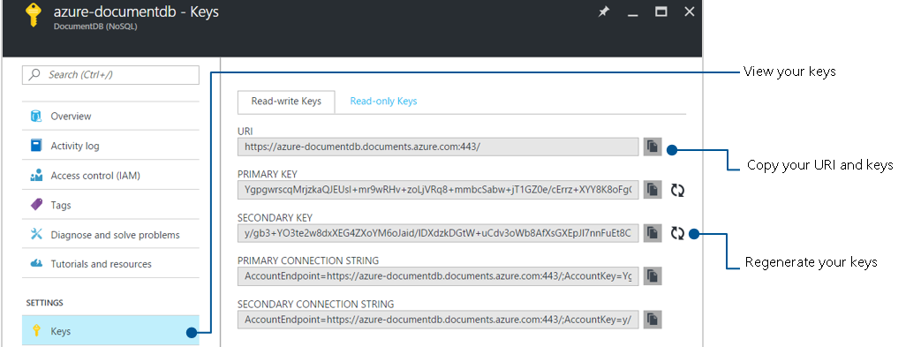
Keys
Master keys
Full administrative access to all resources within a Azure Cosmos DB account
Pair for rotation
Read-only keys
Read-only access to all resources within the account

Slide 29
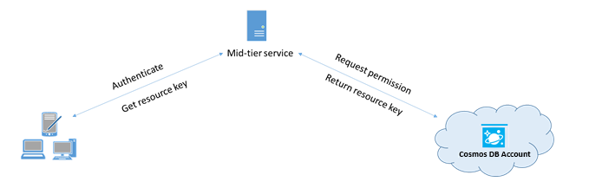
Granular Access
Users
Similar to user resources in other database
Permissions
Grant specific access to a resource or a set of resources
Resource tokens
Creates a relationship between a user and permission

Slide 30
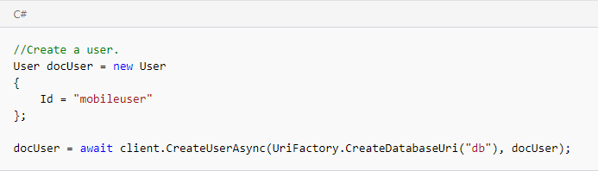
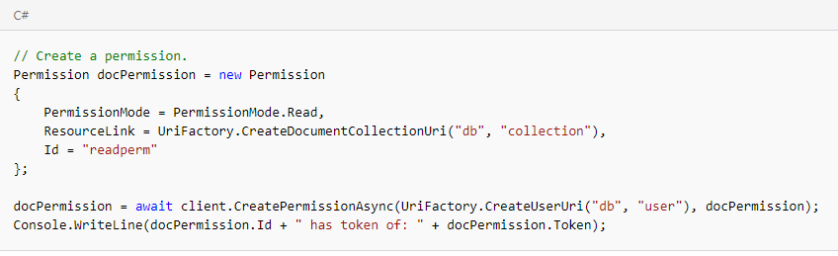
Create and manage users

Slide 31
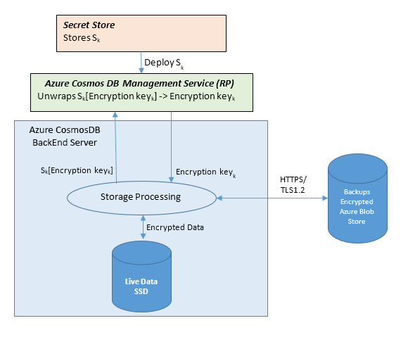
Encryption
https://docs.microsoft.com/en-us/azure/cosmos-db/database-encryption-at-rest
Notes:
The basic flow of a user request is as follows:
The user database account is made ready, and storage keys are retrieved via a request to the Management Service Resource Provider.
A user creates a connection to Cosmos DB via HTTPS/secure transport. (The SDKs abstract the details.)
The user sends a JSON document to be stored over the previously created secure connection.
The JSON document is indexed unless the user has turned off indexing.
Both the JSON document and index data are written to secure storage.
Periodically, data is read from the secure storage and backed up to the Azure Encrypted Blob Store.

Slide 32
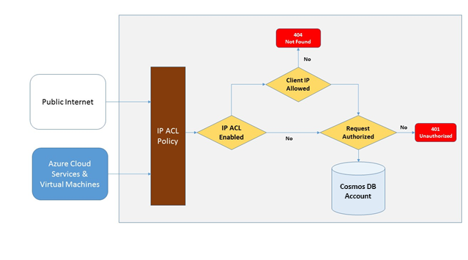
Configure IP firewalls
https://docs.microsoft.com/en-us/azure/cosmos-db/firewall-support

Slide 33
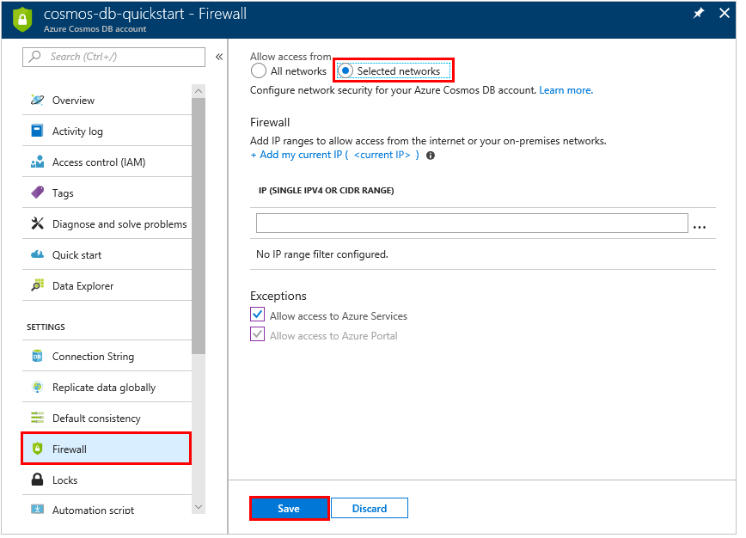
Configure IP firewalls
https://docs.microsoft.com/en-us/azure/cosmos-db/firewall-support

Slide 34
Debug a Cosmos DB solution
Configure diagnostic logging
Recommend solutions based on data retrieved from logs
Evaluate response status code categories
Throttle
Review metrics and performance tips

Slide 35
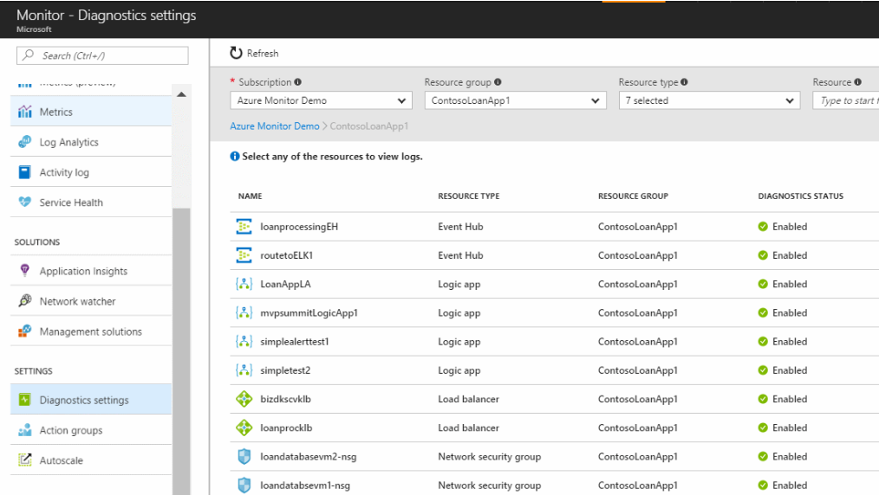
Diagnostic logging
https://docs.microsoft.com/en-us/azure/monitoring-and-diagnostics/monitoring-overview-of-diagnostic-logs

Slide 36
Throttle - Network
Connection policy
Connection mode
Gateway
Direct
Protocol
TCP
HTTPS
OpenAsync
await client.OpenAsync();
Clients in same Azure region for performance
Increase number of threads/task
https://docs.microsoft.com/en-us/azure/cosmos-db/performance-tips

Slide 37
Throttle - SDK
Install the most recent SDK
Use a singleton Azure Cosmos DB client for the lifetime of your application
Tuning parallel queries for partitioned collections
Turn on server-side GC
Implement backoff at RetryAfter intervals
Scale out your client-workload
Use 64-bit host processing
Cache document URIs for lower read latency
https://docs.microsoft.com/en-us/azure/cosmos-db/performance-tips

Slide 38
Throttle - Indexing
Exclude unused paths from indexing for faster writes
https://docs.microsoft.com/en-us/azure/cosmos-db/performance-tips

Slide 39
Throttle - Throughput
Measure and tune for lower request units/second usage
Handle rate limiting/request rate too large
Design for smaller documents for higher throughput
https://docs.microsoft.com/en-us/azure/cosmos-db/performance-tips

Slide 40
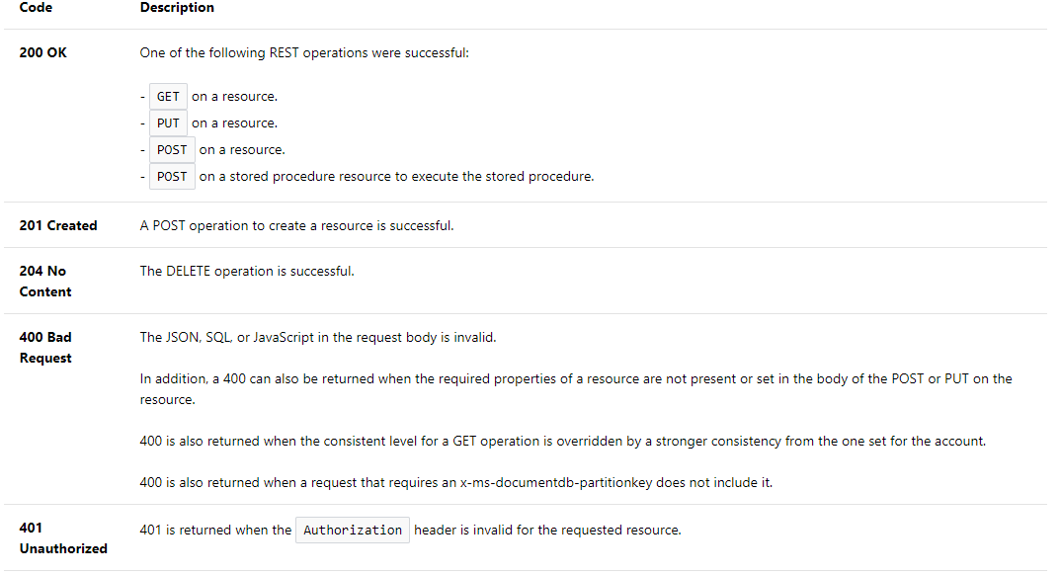
Status code categories
https://docs.microsoft.com/en-us/rest/api/cosmos-db/http-status-codes-for-cosmosdb

Slide 41

Thank you and Q&A

